Slide 1
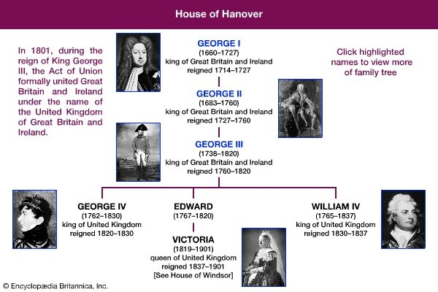
THE EIGHTEENTH CENTURy
Week 13
Notes:
Before the end of the eighteenth century, Britain was as powerful as France. This resulted from the growth of its industries and from the wealth of its large new trading empire. Britain now had the strongest navy in the world; the navy controlled Britain's own trade routes and endangered those of its enemies. Power belonged to the groups from which the ministers came, and their supporters in Parliament. These ministers ruled over a country which had become wealthy through trade. This wealth, or "capital," made possible both an agricultural and an industrial revolution which made Britain the most advanced economy in the world.

Slide 2

General ınfo
Growth of industries
Trading empire
Britain now had the strongest navy in the World.
Kings ministers became poweful and decision-makers.
Industrial revolution
Proleteriat as a new emerging class came out
Machinary replaced the cottage industries
Poverty led to the revolution (Age of Revolution)

Slide 3
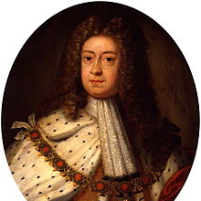
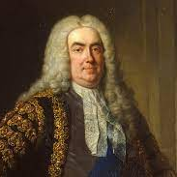
Politics and finance
From the website Wikipedia
George I
When Queen Anne died in 1714, the Protestant ruler of Hanover, George became king.
Government power was increased (German-English)
Robert Walpole (first prime minister) remained the greatest political leader for over twenty years.
From the website History of Government
Robert Walpole

Slide 4
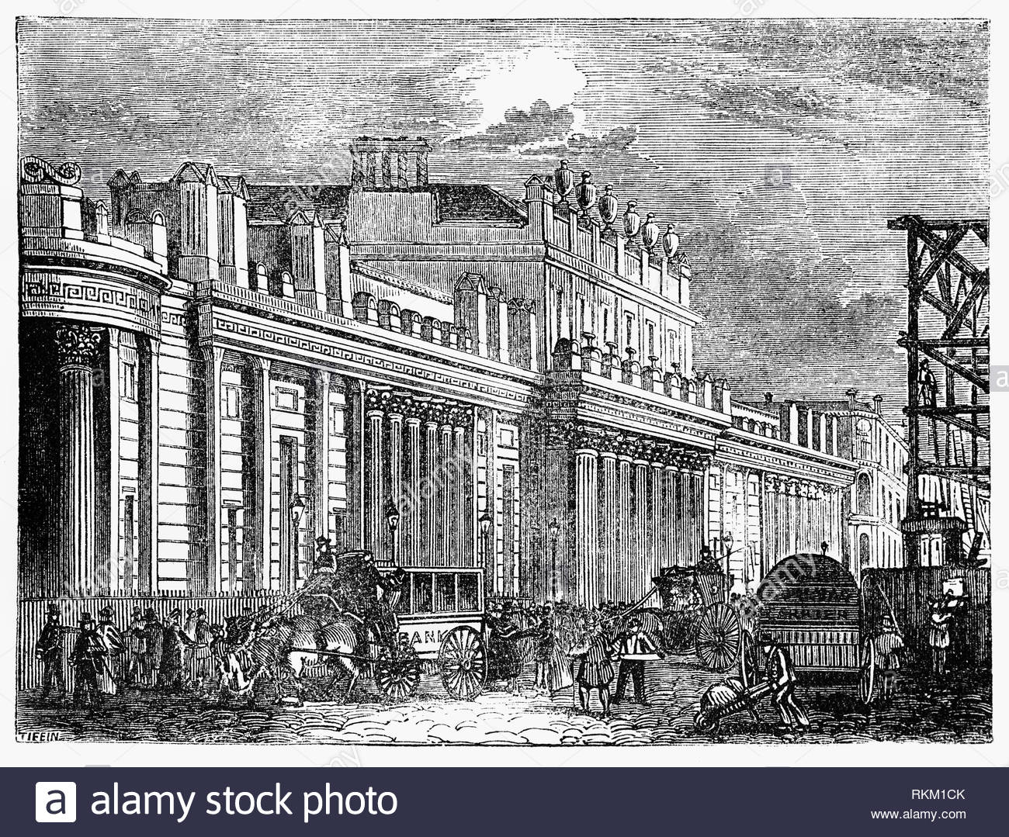
In 1694, a group of financiers decided to establish a bank, and the government agreed to borrow from it alone.
The new bank, called the Bank of England, had authority to raise money by printing "bank notes."
From the website Alamy

Slide 5
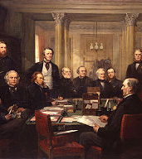
From the website Wikipedia
Walpole developed the idea of «Cabinet» whose members were together responsible for policy decisions.
The limits to monarchy were these:
    the king could not be a Catholic.
    the king could not remove or change laws.
    the king was dependent on Parliament for his financial income and for his army.
    The king was supposed to "choose" his ministers.

Slide 6
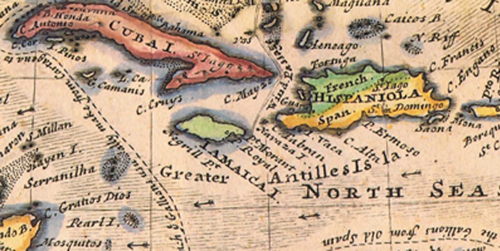
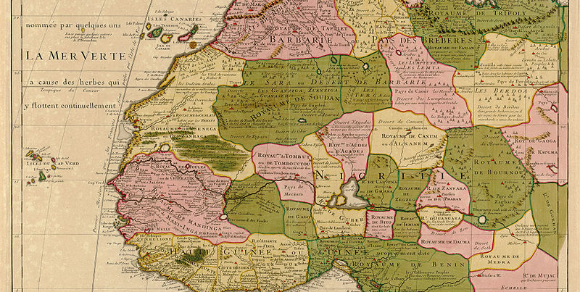
From the website Linda Lee Graham
From the website Wikipedia
the West Indies were the most profitable part of Britain's new empire.
British-made knives, swords and cloth were taken to West Africa and exchanged for slaves.
These were taken to the West Indies, and the ships returned to Britain carrying sugar which had been grown by slaves.

Slide 7
John Wilkes and Liberty
Parliament was not democratic at all.
One MP, John Wilkes believed that politics should be open to free discussion by everyone.
He disliked George III and his private allies and enemies.
He attacked hi in his own newspaper, The North Briton and got arrasted
His supporters, known as "Wilkites," rallied under the slogan "Wilkes and Liberty," advocating for freedom of speech and electoral rights. Wilkes’s persistent efforts laid the groundwork for future political reforms in Britain, and his legacy as a symbol of liberty and democratic principles continues to be recognized.

Slide 8
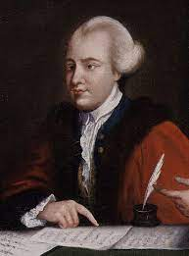
From the website Wikipedia
"Conversation" clubs met in different towns to discuss.
The age of public opinion arrived.

Slide 9
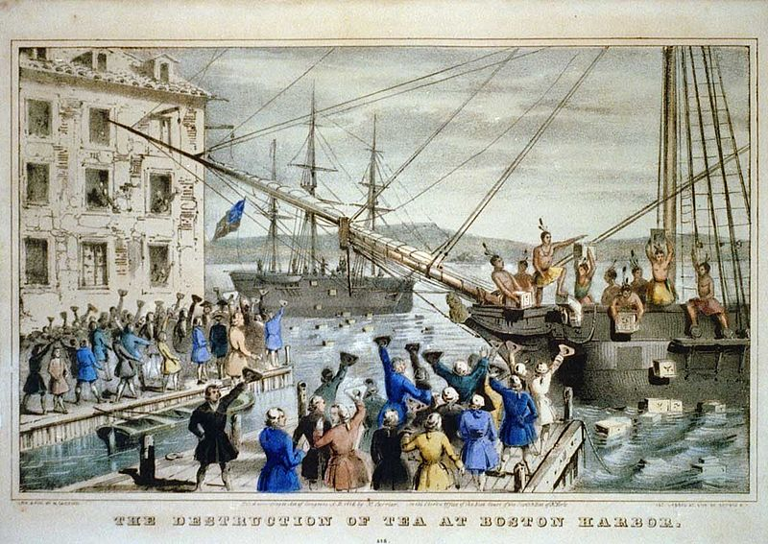
Radicalism and the loss of the American colonies
From the website Wikipedia
BOSTON TEA PARTY

Slide 10
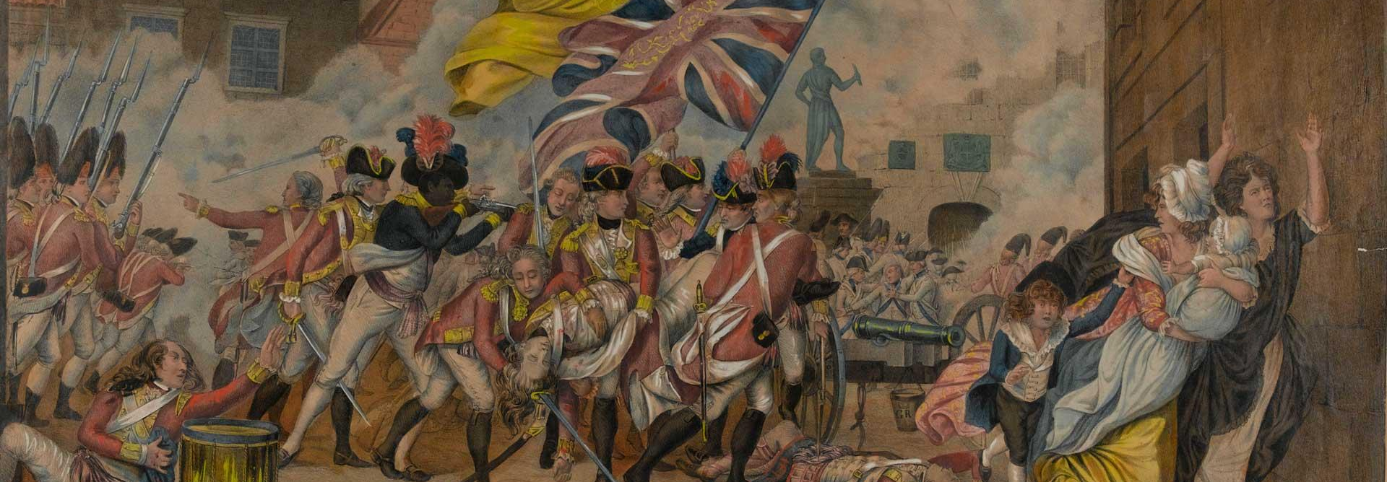
From the website National Army
In 1773 a group of colonists at the port of Boston threw a shipload of tea into the sea rather than pay tax on it. The event became known as "the Boston Teapartv."
The American War of Independence had begun (1775 - 1783).

Slide 11
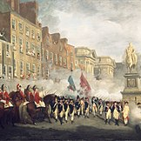
Ireland
From the website Wikipedia
By the 1770s some of the worst laws against Catholics were removed.
Protestants formed the first "Orange Lodges," societies which were against any freedom for the Catholics.
In order to increase British control, Ireland was united with Britain in 1801, and the Dublin parliament closed.

Slide 12
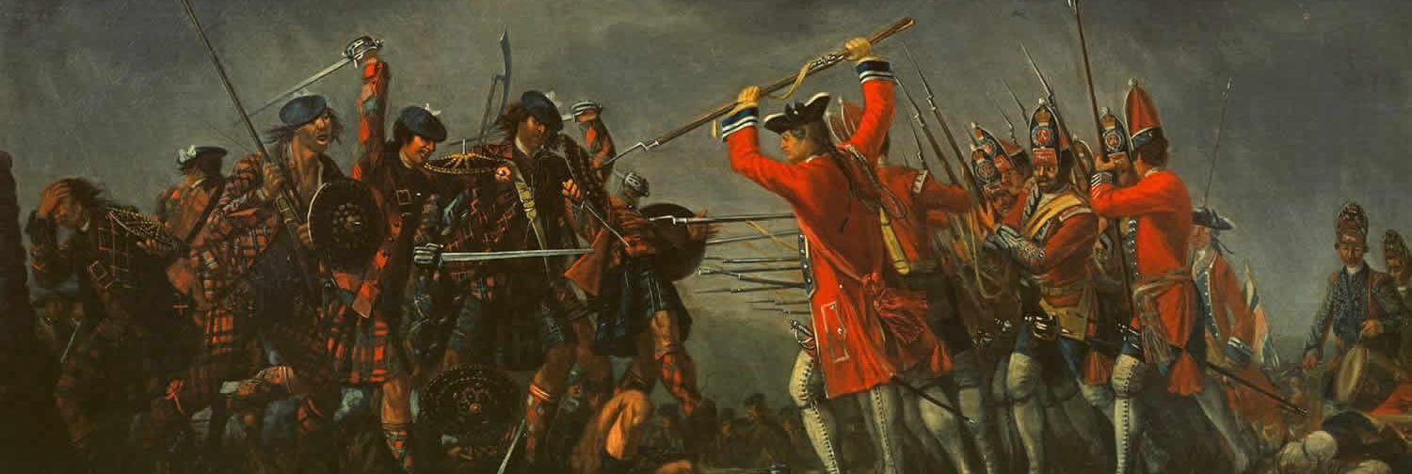
Scotland
From the website Travel Scotland
Early in 1746 the Jacobites were defeated by the British army.
A law was passed; the old patterns of the kilt and the Scottish musical instrument, the bagpipe, were forbidden.

Slide 13
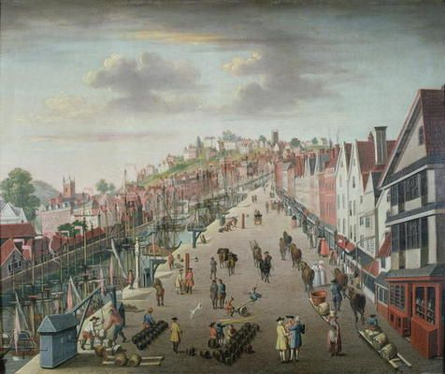
LIFE IN TOWN AND COUNTRY
From the website Pinterest

Slide 14
There were four main classes of people in eighteenth-century towns:
    the wealthy merchants;
    the ordinary merchants and traders;
    the skilled craftsmen;
    the large number of workers

Slide 15
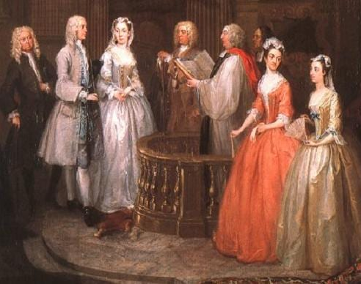
Women were only allowed to amuse themselves. Girls continued to be victims of the parents' desire to make them match the popular idea of feminine beauty of slim bodies, tight waists and a pale appearance.
From the website WordPress

Slide 16
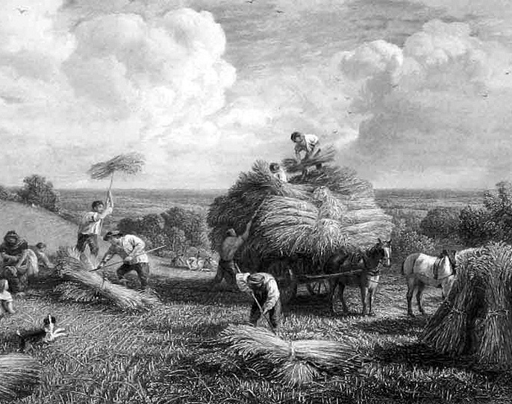
Each village stood in the middle of three or four large fields, and the villagers together decided what to grow.
During the eighteenth century most of this land was enclosed.
From the website The Craven Herald

Slide 17
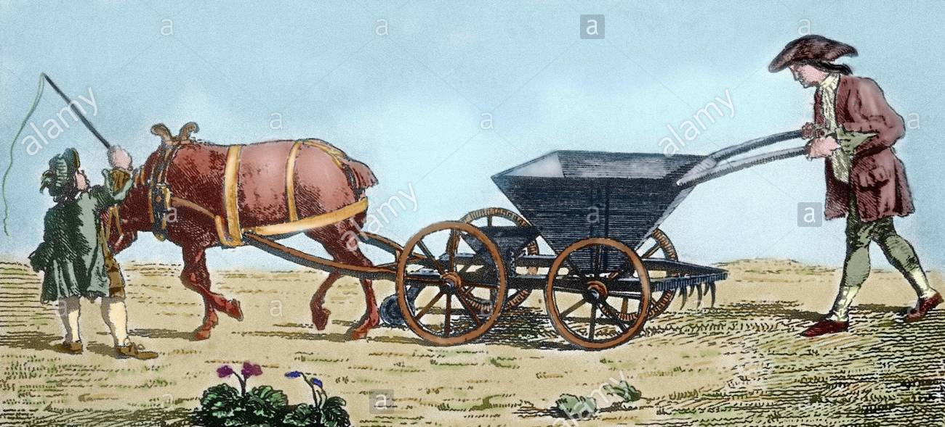
a "seed drill," a machine for sowing corn seed in straight lines and at fixed intervals, was invented.
From the website Alamy

Slide 18
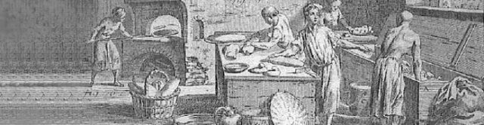
From the website Federation of Bakers

Slide 19
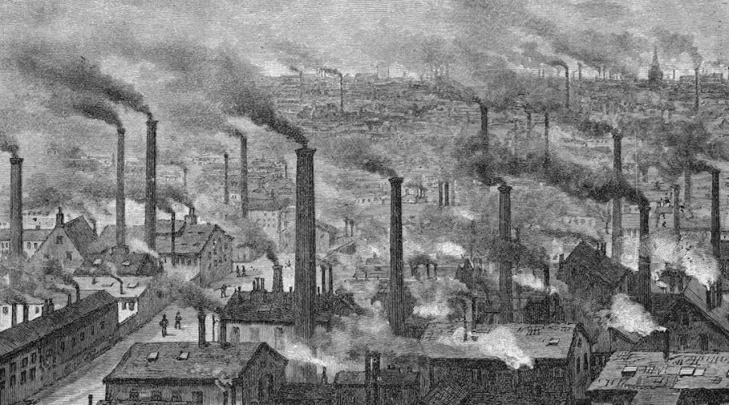
INDUSTRIAL REVOLUTION
Industrial revolution
(1760-1840)
Romanticism
1780-1830s)
From the website Merchanst and Mechanics

Slide 20
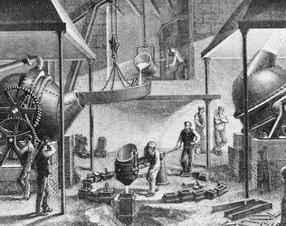
Iron:
John Wilkinson, a man with a total belief in iron, built the largest ironworks in the country.
He built the world's first iron bridge, over the River Severn, in 1779.
From the website ThoughtCo

Slide 21
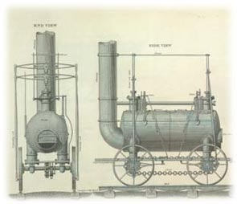
Steam:
In 1781 Watt produced an engine with a turning motion, made of iron and steel.
The invention—and perfection—of the steam engine was closely connected to the Scientific Revolution.
From the website WordPress
Notes:
* Until then steam engines had only been used for pumping, usually in coal mines.
- It was a vital development because people were now no longer dependent on natural power, basic materials of the industrial revolution were cotton and woollen cloth, which were popular abroad.
-- The steam engine was an important application of knowledge discovered by 17th-century scientists. The science began with Galileo, who was the first to suspect that the atmosphere had weight. The idea occurred to him when he studied the problem of draining mines, and he noticed that suction pumps would not lift water more than about 30 feet.

Slide 22
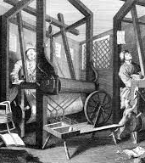
Cotton:
Merchants brought raw cotton to women who spun it on wheels in their cottages in return for wages.
In 1764 a spinning machine was invented which could do the work of several hand spinners, and other improved machines were made shortly after.
In 1785 a power machine for weaving revolutionised cloth-making.
From the website British Heritage

Slide 23
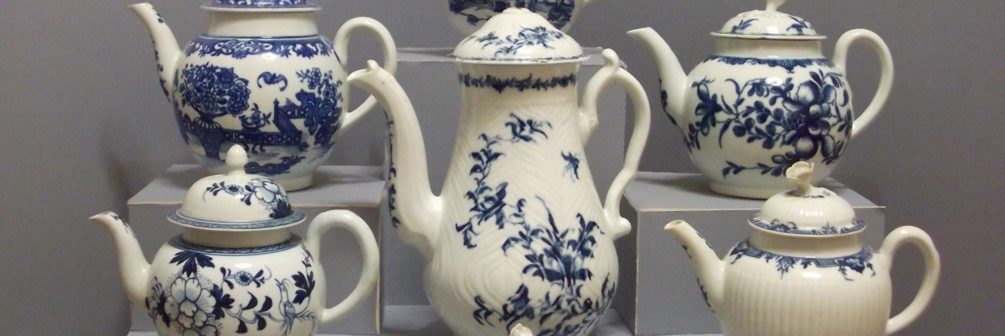
Ceramics:
From the website English Porcelain Online
In the Midlands, factories using locally found clay began to develop very quickly and produced fine quality plates, cups and other china goods.

